Slide 1

Year 9 Poetry By Heart
2021 class competition

Slide 2

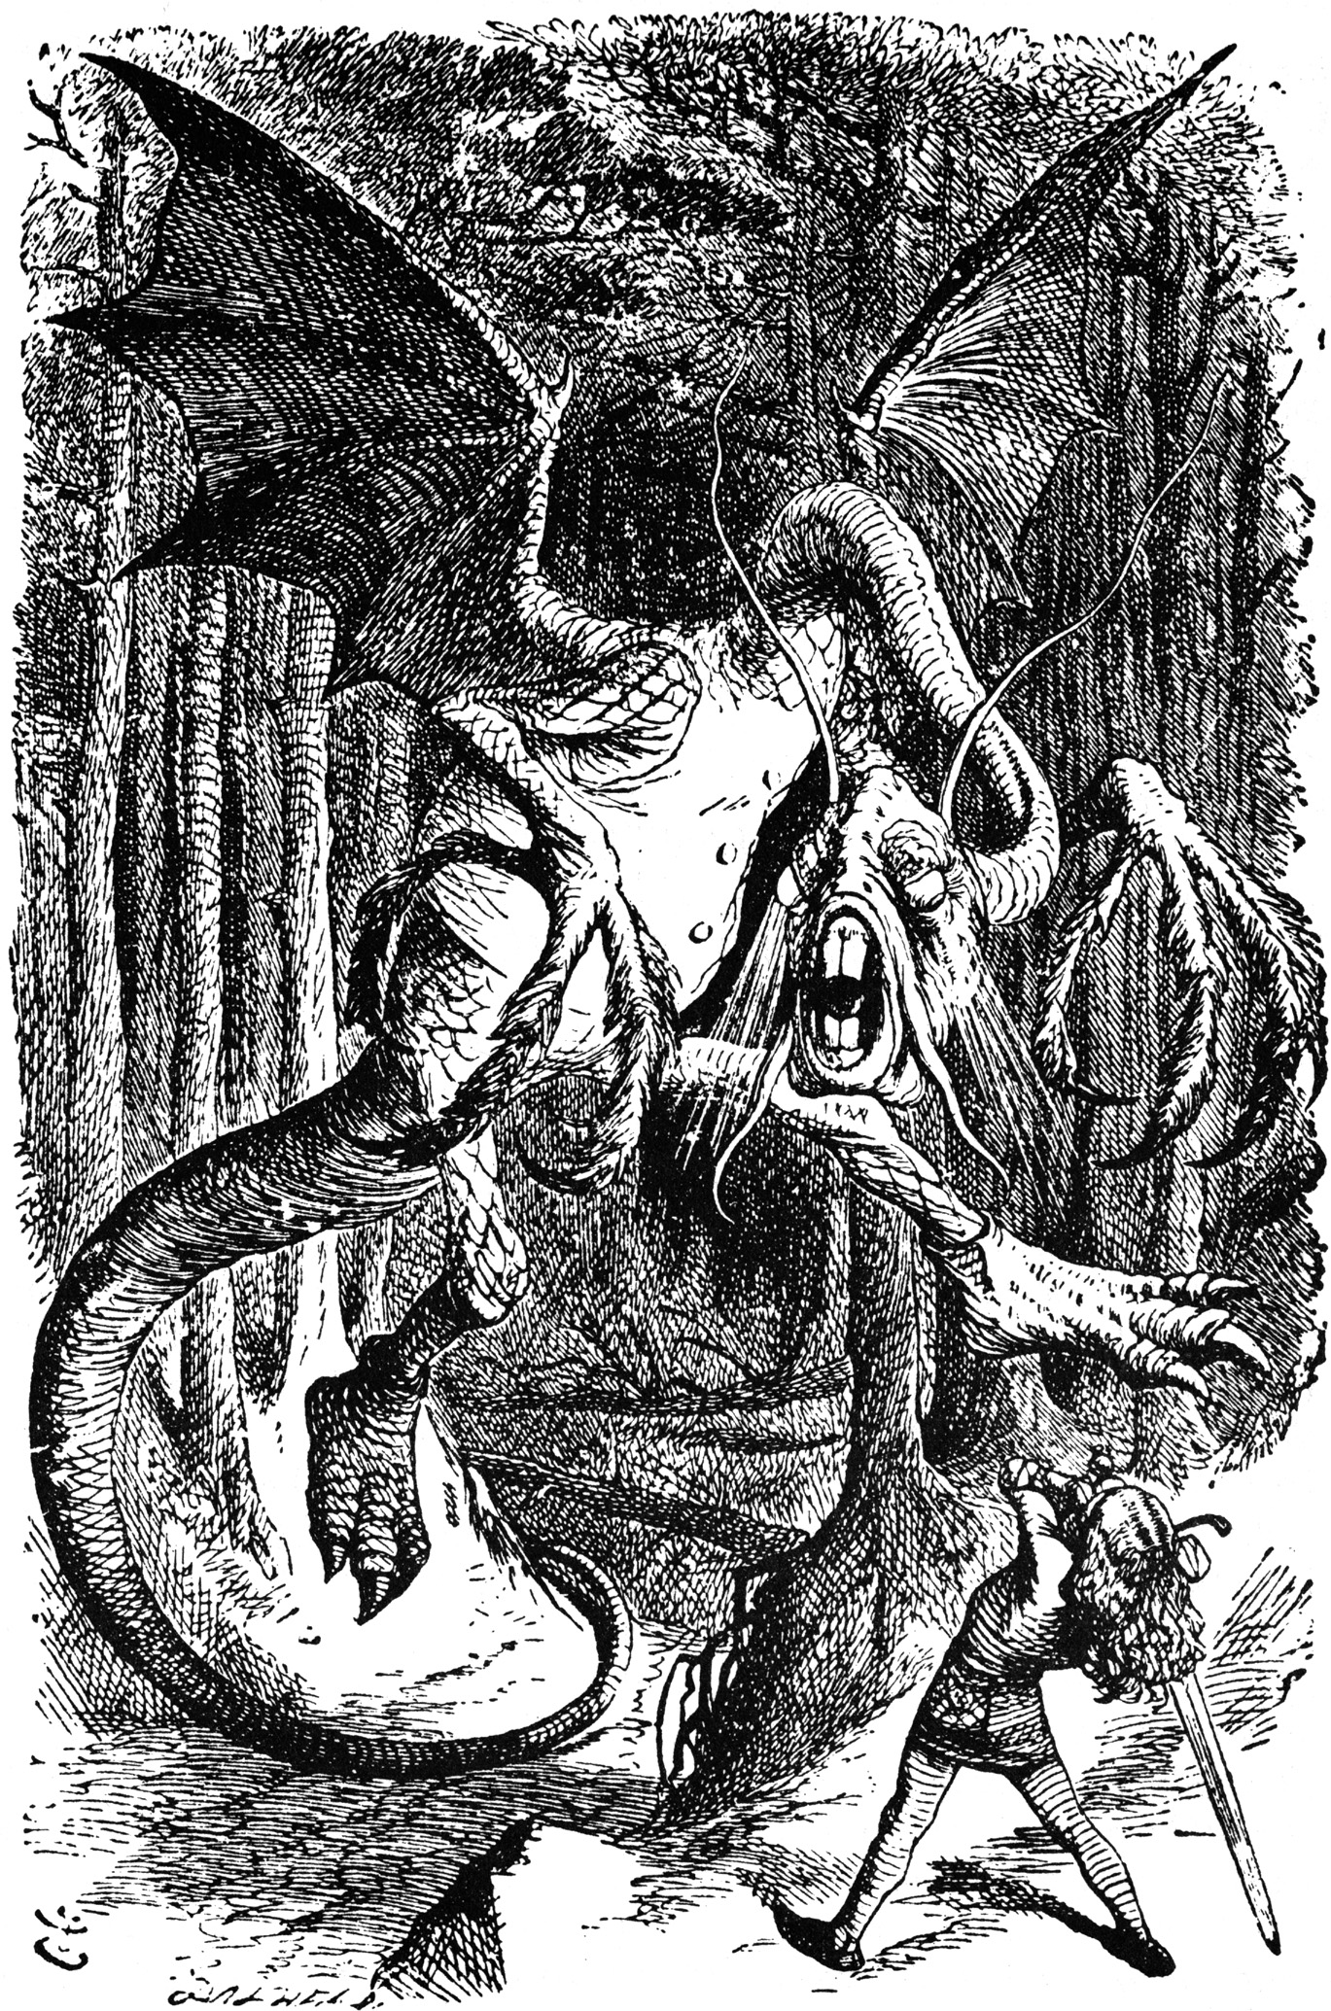
Competition outline- updated!
Following the move to online learning, we have been discussing ways for this year’s competition to still go ahead. We have taken the decision to follow the global trend and move online to enable you to share the brilliant work you will have prepared over Christmas. So, this time, you can recite your poem from the comfort of your own home: what could be better?
Competition details:
Choose one poem from the six in our anthology.
Learn the whole poem off by heart
Record yourself reciting your poem in full, and send this to your teacher via Google Classroom by Friday 29th January at 15:30.
Take part in this whole-year competition with your peers to become Silverdale’s newest poetry reciting champion!
The national winner gets the chance to travel to the US to compete there- all expenses paid!
Can you guess what famous nonsense poem this picture is inspired by?

Slide 3
Competition outline- updated!
Following the move to online learning, we have been discussing ways for this year’s competition to still go ahead. We have taken the decision to follow the global trend and move online to enable you to share the brilliant work you will have prepared over Christmas. So, this time, you can recite your poem from the comfort of your own home: what could be better?
How do I best to record myself?
Record a video of yourself on your phone, tablet or computer/ laptop
Where do I send my work?
Send it in via the appropriate Google Classroom tab by the submission deadline
Do I have to do this?
Yes! You all prepared for this over the Christmas holiday, and we want to give you a chance to share your brilliance.
Who will see my entry?
The recordings will be judged by Mrs Senior, Mr Benn, Mr Bushell and Mr Newton.
Remember: it has to be a video- no cheating!
Competition details:
Choose one poem from the anthology
Learn the whole poem off by heart
Record yourself reciting your poem in full, and send this to your teacher via Google Classroom by Friday 29th January at 15:30.
Take part in this whole-year competition with your peers to become Silverdale’s newest poetry reciting champion!
The national winner gets the chance to travel to the US to compete there- all expenses paid!

Slide 4
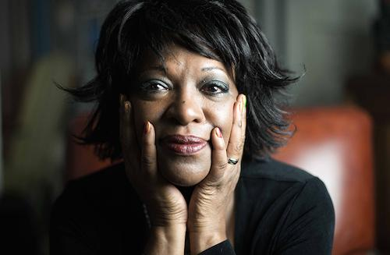
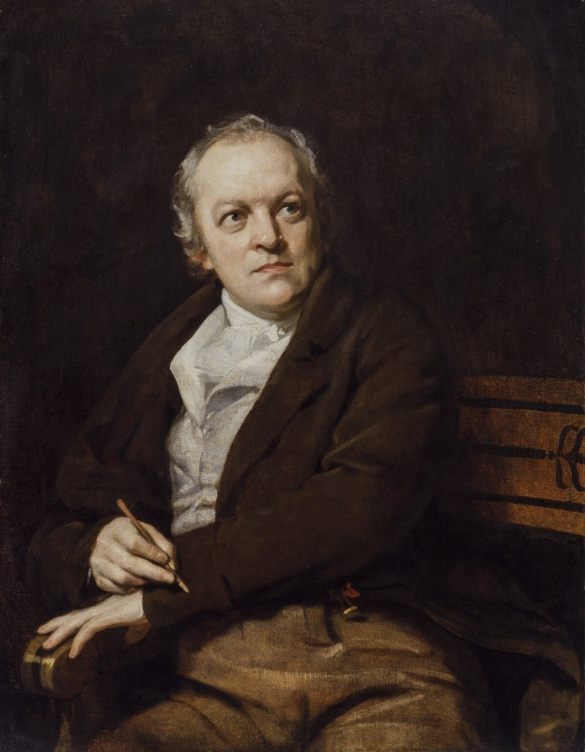
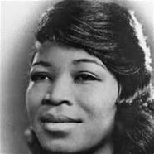
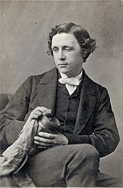
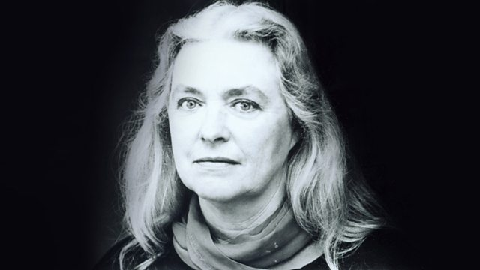
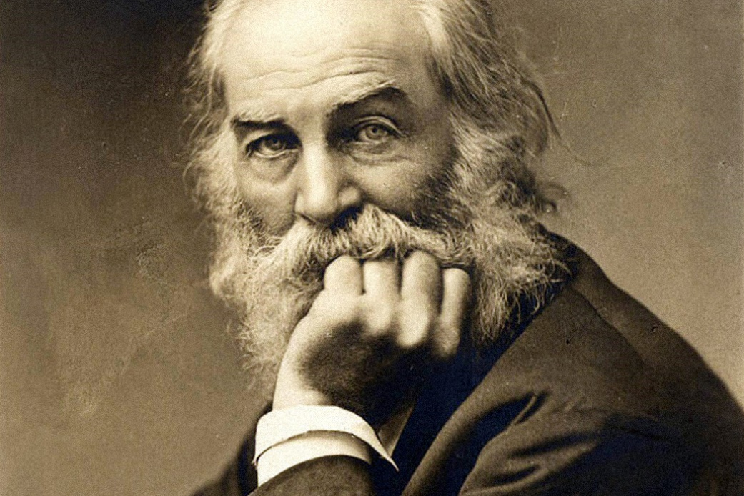
Introducing this year’s poets…

Slide 5
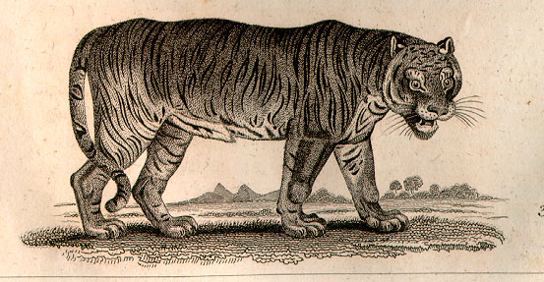
The Tyger, by William Blake (1794)
William Blake was a mystic, poet, engraver, illustrator and radical influenced by the French Revolution.
He first combined his skill as an engraver and his talent for poetic expression in Songs of Innocence- a collection we study in A Level English Literature.
Blake makes use of symbols and is often a passionate protester against theological and political tyranny of any kind, never more so than in his poem London in the GCSE poetry anthology.
In this poem, Blake wonders who could have made a creature so regal, so powerful and so mighty as the tiger.
“Tyger! Tyger! burning bright”
https://www.youtube.com/watch?v=tGVEI12eKFE

Slide 6
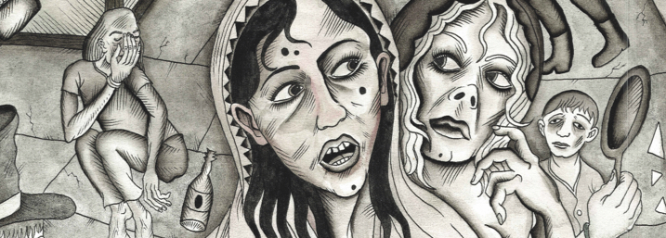
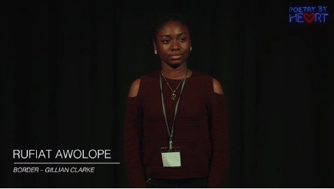
Border, by Gillian Clarke (1989)
In 2008 Gillian Clarke was appointed National Poet of Wales, having been the Capital Poet for Cardiff in 2005 and 2006; in 2010 she was awarded the Queen’s Gold Medal for Poetry.
She is a writer who believes in the richness and power of both Welsh and English. She once said that she felt Welsh was the language in which Wales speaks to itself and English the language it uses to speak to the world. The interplay between the past and the present, the land and the people who inhabit it, is often seen in her work.
https://www.poetrybyheart.org.uk/poems/border/

Slide 7
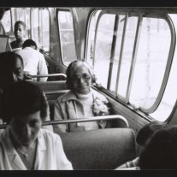
Rosa, by Rita Dove (1999)
Rita Dove studied English at Miami University and won a prestigious Fulbright Scholarship to study literature in Germany. Winner of the Pulitzer Prize for her verse-novel Thomas and Beulah, in 1993 she became the youngest ever American Poet Laureate and the first black American to be elected to this post.
Dove is a sensual, lyrical poet, and her poems often explore female black experience and social history. Her intimate style is said to be capable of dissolving the barriers between the present and the past. Featuring famous black American women, such as Rosa Parks and Billie Holiday, as well as more anonymous, every‑day characters, her poems explore what Dove calls the ‘underside of history’.
“the clean flame of her gaze
carved by a camera flash.”

Slide 8
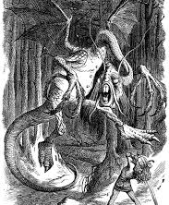
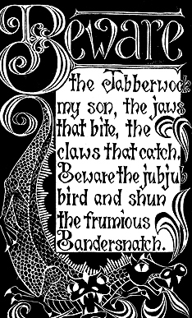
Jabberwocky, by Lewis Carroll (1871)
Lewis Carroll was the alternative title used by Charles Dodgson, who lectured in maths at Oxford University. He is best known for his surreal novels Alice’s Adventures in Wonderland and Through the Looking Glass.
In addition, he created games and puzzles to help explain the principles of logic and was a highly accomplished photographer.
https://www.youtube.com/watch?v=Q_Um3787fSY

Slide 9

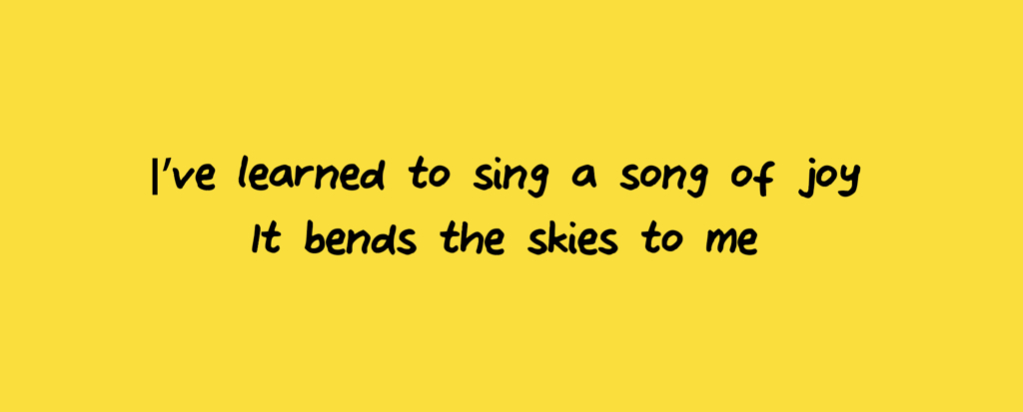
I’ve learned to sing a song of hope, by Georgia Douglas Johnson (1941)
A member of the Harlem Renaissance, Georgia Douglas Johnson wrote plays, a syndicated newspaper column, and four collections of poetry. Johnson was born in Atlanta, Georgia, to parents of African American, Native American, and English descent. Johnson received an honorary doctorate in literature from Atlanta University in 1965.
Her poem I’ve learned to sing a song of hope speaks to a realisation that love and happiness are a “blessing”, the power of which we don’t fully realise until we grow “to maturity”- the power of value of learning!

Slide 10
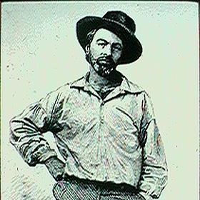
The Beasts, by Walt Whitman (1855)
Whitman is regarded as one of America’s most significant and popular poets. Stylistically innovative and compassionate in tone, he believed in the vital importance of the relationship between the poet and society.
His poem The Beasts acts as an ode to animals- the opening lines, “I think I could turn and live with animals, they are so placid and self-contain’d”, reveals the poet’s desire to live a life among animals, separate from humans who he implies “sweat and whine about their condition” on the earth. Note, however, the irony contained within the title of the poem…
https://www.youtube.com/watch?v=Wl9PN56GMBM

Slide 11
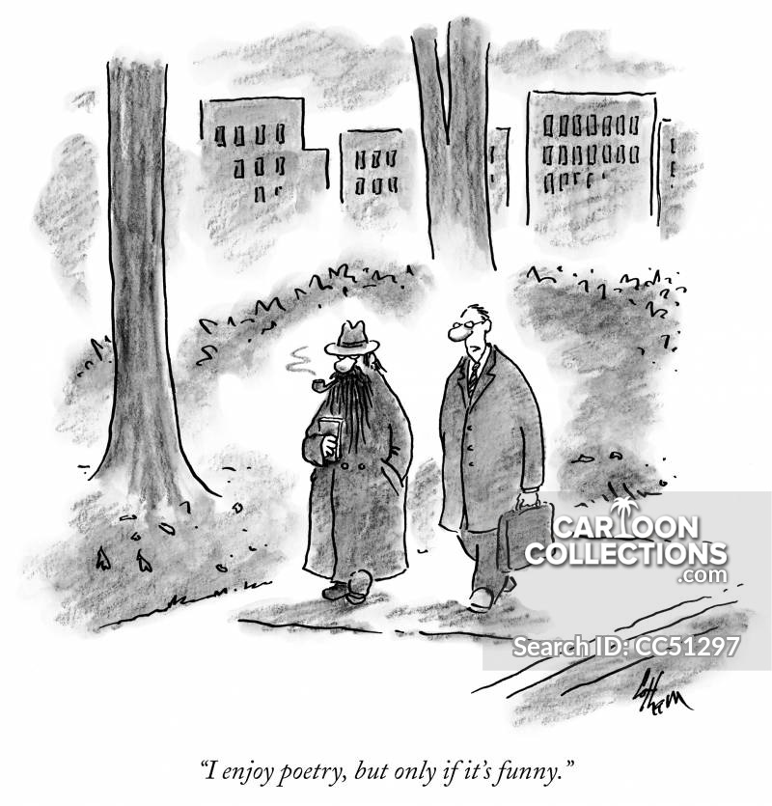
Good luck!
So, don’t forget to choose a poem that you enjoy, and
Competition details:
Choose one poem from the anthology
Learn the whole poem off by heart over the Christmas holiday ready for the first week back (wc 4th Jan)
Take part in the whole-year competition with your peers to become Silverdale’s newest poetry reciting champion!
The national winner gets the chance to travel to the US to compete there- all expenses paid!

